Slide 1

REAL TIME RESEARCH PROJECT
PRESENTED BY:
BATCH – 19
V.Shireesha - 247R1A05C8
B.Rakesh - 247R1A0571
K.Aasritha - 247R1A0564
D.Anitha - 257R5A0509
UNDER THE GUIDANCE OF:
G PAVAN KUMAR
(Assistant Professor)

Slide 2
TITLE : Child ADHD Disease Detection Using Pose Estimation Technique

Slide 3
INTRODUCTION :
Attention Deficit Hyperactivity Disorder (ADHD) is a neurodevelopmental disorder commonly found in children. It affects attention span, behavior, and activity levels. Early detection helps in better treatment and support. With the advancement of Artificial Intelligence and Computer Vision, pose estimation techniques can analyze body movements and behavioral patterns to assist in ADHD detection.

Slide 4
EXISTING SYSTEM:
Traditional ADHD detection mainly relies on psychological tests, behavioral observation, and questionnaires from parents and teachers. These methods require significant time and expert evaluation. They may also be subjective and sometimes inaccurate.

Slide 5
DISADVANTAGES IN EXISTING SYSTEM
• Time-consuming clinical diagnosis process.
• Subjective evaluation by doctors and parents.
• Difficult to monitor children's behavior continuously.
• Requires trained medical professionals.

Slide 6
PROPOSED SYSTEM :
The proposed system uses pose estimation techniques with computer vision to detect ADHD-related behavioral patterns in children. Video frames are analyzed to track body posture, movements, and activity levels. Machine learning algorithms analyze these patterns to detect possible ADHD symptoms. This automated approach supports early and objective detection.

Slide 7
ADVANTAGES :
• Automatic behavior monitoring.
• Early ADHD detection support.
• Reduces human bias in diagnosis.
• Non-invasive and easy to use.
• Can analyze large amounts of behavioral data.

Slide 8
SYSTEM REQUIREMENTS :
HARDWARE REQUIREMENTS:
• System: Pentium Dual Core or above
• Hard Disk: 120 GB
• Monitor: 15'' LED
• Input Devices: Keyboard, Mouse
• RAM: 4 GB
SOFTWARE REQUIREMENTS:
• Operating System: Windows 10/11
• Coding Language: Python
• Tool: PyCharm / VS Code
• Libraries: OpenCV, MediaPipe, NumPy, Scikit-learn
• Framework: Machine Learning

Slide 9
NOVELTY OF THE PROJECT :
• Uses pose estimation to analyze children's movements.
• Applies AI and machine learning for behavioral pattern recognition.
• Provides automated assistance for ADHD screening.
• More objective and data-driven compared to traditional methods.

Slide 10
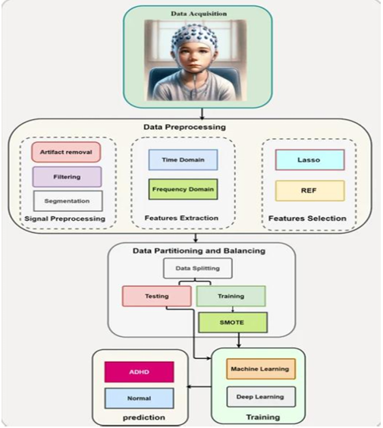
SYSTEM ARCHITECTURE :

Slide 11
MODULES :
1. Video Data Collection
2. Pose Estimation Module
3. Feature Extraction Module
4. Machine Learning Classification Module
5. Result Visualization Module

Slide 12
UML DIAGRAMS :
Unified Modeling Language (UML) diagrams are used to visually represent the design and structure of the system.

Slide 13
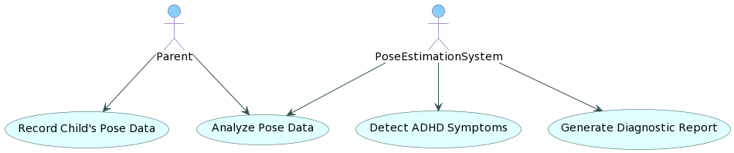
USE CASE DIAGRAM :
Shows the interaction between users and the system.

Slide 14
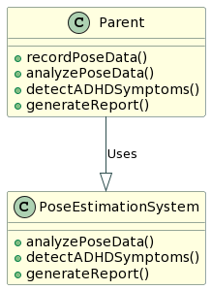
CLASS DIAGRAM :
Describes system classes, attributes, and relationships.

Slide 15
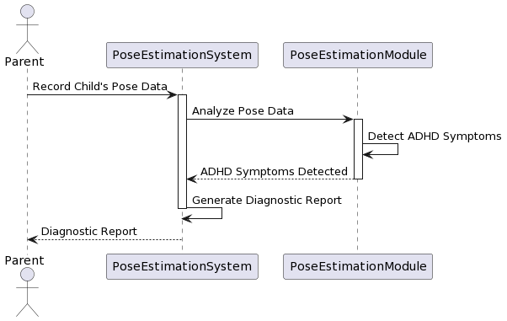
SEQUENCE DIAGRAM :
Shows the sequence of interactions between system components.

Slide 16
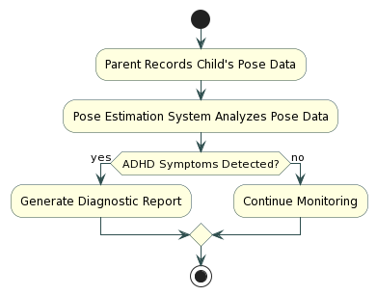
ACTIVITY DIAGRAM :
Represents the workflow of the system processes.

Slide 17
SOURCE CODE
from tkinter import messagebox
from tkinter import *
from tkinter import simpledialog
import tkinter
import matplotlib.pyplot as plt
import numpy as np
from tkinter import ttk
from tkinter import filedialog
import pandas as pd
from sklearn.model_selection import train_test_split
import os
import cv2
from sklearn.preprocessing import StandardScaler
from sklearn.metrics import accuracy_score
from sklearn import svm
from sklearn.metrics import accuracy_score
from sklearn.metrics import f1_score
from sklearn.metrics import precision_score
from sklearn.metrics import recall_score
import matplotlib.pyplot as plt
import seaborn as sns
import os
from sklearn.metrics import confusion_matrix
main = Tk()
main.title("Children ADHD Disease Detection using Pose Extimation Technique")
main.geometry("1300x1200")
global filename
global X, Y
global X_train, X_test, y_train, y_test, scaler, svm_cls
global dataset
proto_File = "Models/pose_deploy_linevec.prototxt"
weights_File = "Models/pose_iter_440000.caffemodel"
n_Points = 18
POSE_PAIRS = [ [1,0],[1,2],[1,5],[2,3],[3,4],[5,6],[6,7],[1,8],[8,9],[9,10],[1,11],[11,12],[12,13],[0,14],[0,15],[14,16],[15,17]]
in_Width = 368
in_Height = 368
threshold = 0.1
POSE_NAMES = ["Head", "Neck", "RShoulder", "RElbow", "RWrist", "LShoulder", "LElbow", "LWrist", "RHip", "RKnee",
"RAnkle", "LHip", "LKnee", "LAnkle", "Chest", "Background"]
net = cv2.dnn.readNetFromCaffe(proto_File, weights_File)
net.setPreferableBackend(cv2.dnn.DNN_TARGET_CPU)

Slide 18
def uploadDataset():
global filename, dataset
filename = filedialog.askopenfilename(initialdir="ADHDDataset")
text.delete('1.0', END)
text.insert(END,filename+" loaded\n\n")
dataset = pd.read_csv(filename)
text.insert(END,str(dataset.head()))
def processDataset():
global dataset, X, Y, scaler
text.delete('1.0', END)
data = dataset.values
X = data[:,0:data.shape[1]-1]
Y = data[:,data.shape[1]-1]
indices = np.arange(X.shape[0]) #shuffling dataset values
np.random.shuffle(indices)
X = X[indices]
Y = Y[indices]
scaler = StandardScaler()
X = scaler.fit_transform(X)
text.insert(END,"Dataset Processing, Shuffling & Normalization Completed\n\n")
text.insert(END,"Normalized Dataset Values = "+str(X))
def splitDataset():
text.delete('1.0', END)
global X, Y, X_train, X_test, y_train, y_test
X_train, X_test, y_train, y_test = train_test_split(X, Y, test_size=0.2)
text.insert(END,"Total records found in Dataset : "+str(X.shape[0])+"\n")
text.insert(END,"Total features found in each record : "+str(X.shape[1])+"\n")
text.insert(END,"Dataset Train & Test Split\n")
text.insert(END,"80% dataset size used to train algorithms : "+str(X_train.shape[0])+"\n")
text.insert(END,"20% dataset size used to test algorithms : "+str(X_test.shape[0])+"\n")
def calculateMetrics(algorithm, predict, y_test):
label = ['Normal', 'ADHD Disease']
a = accuracy_score(y_test,predict)*100
p = precision_score(y_test, predict,average='macro') * 100
r = recall_score(y_test, predict,average='macro') * 100
f = f1_score(y_test, predict,average='macro') * 100
text.insert(END,algorithm+" Accuracy : "+str(a)+"\n")
text.insert(END,algorithm+" Precision : "+str(p)+"\n")
text.insert(END,algorithm+" Recall : "+str(r)+"\n")

Slide 19
text.insert(END,algorithm+" FScore : "+str(f)+"\n")
conf_matrix = confusion_matrix(y_test, predict)
plt.figure(figsize =(6, 3))
ax = sns.heatmap(conf_matrix, xticklabels = label, yticklabels = label, annot = True, cmap="viridis" ,fmt ="g");
ax.set_ylim([0,len(label)])
plt.title(algorithm+" Confusion matrix")
plt.xticks(rotation=90)
plt.ylabel('True class')
plt.xlabel('Predicted class')
plt.show()
def trainSVM():
global svm_cls
text.delete('1.0', END)
global X_train, X_test, y_train, y_test
svm_cls = svm.SVC(kernel="rbf", C = 12, probability=True, gamma="auto")
svm_cls.fit(X_train, y_train)
predict = svm_cls.predict(X_test)
calculateMetrics("SVM", predict, y_test)
def predictADHD(testData):
values = []
testData = np.asarray(testData)
values.append(testData)
testData = np.asarray(values)
testData = scaler.transform(testData)
predict = svm_cls.predict(testData)
return int(predict[0])
def detectDisease(frame):
global net
frame_Width = frame.shape[1]
frame_Height = frame.shape[0]
img = np.zeros((frame_Height,frame_Width,3), dtype=np.uint8)
inp_Blob = cv2.dnn.blobFromImage(frame, 1.0 / 255, (in_Width, in_Height), (0, 0, 0), swapRB=False, crop=False)
net.setInput(inp_Blob)
output = net.forward()
H = output.shape[2]
W = output.shape[3]
points = []
testData = []

Slide 20
print(str(pair[0])+" "+str(pair[1])+" "+str(partA)+" "+str(partB))
if points[partA] and points[partB]:
cv2.line(img, points[partA], points[partB], (0, 255, 255), 3, lineType=cv2.LINE_AA)
cv2.line(frame, points[partA], points[partB], (0, 255, 255), 3, lineType=cv2.LINE_AA)
cv2.circle(frame, points[partA], 8, (0, 0, 255), thickness=-1, lineType=cv2.FILLED)
cv2.circle(frame, points[partB], 8, (0, 0, 255), thickness=-1, lineType=cv2.FILLED)
return frame, img, predict
def imageDetect():
text.delete('1.0', END)
global scaler, svm_cls
filename = filedialog.askopenfilename(initialdir="images")
frame = cv2.imread(filename)
frame, img, predict = detectDisease(frame)
frame = cv2.resize(frame, (400, 400))
img = cv2.resize(img, (400, 400))
label = ['Normal', 'ADHD Disease']
print(predict)
for i in range(n_Points):
probMap = output[0, i, :, :]
minVal, prob, minLoc, point = cv2.minMaxLoc(probMap)
x = (frame_Width * point[0]) / W
y = (frame_Height * point[1]) / H
if prob > threshold :
cv2.circle(frame, (int(x), int(y)), 8, (0, 255, 255), thickness=-1, lineType=cv2.FILLED)
cv2.putText(frame, "{}".format(i), (int(x), int(y)), cv2.FONT_HERSHEY_SIMPLEX, 1, (0, 0, 255), 2, lineType=cv2.LINE_AA)
points.append((int(x), int(y)))
testData.append(x)
testData.append(y)
else :
points.append(None)
testData.append(0)
testData.append(0)
predict = predictADHD(testData)
for pair in POSE_PAIRS:
partA = pair[0]
partB = pair[1]

Slide 21
cv2.putText(frame, 'Predicted As : '+label[predict], (10, 25), cv2.FONT_HERSHEY_SIMPLEX,0.7, (0, 0, 255), 2)
cv2.imshow("Pose Estimated Image", frame)
cv2.imshow("Pose Image", img)
cv2.waitKey(0)
def videoDetect():
text.delete('1.0', END)
global scaler, svm_cls
filename = filedialog.askopenfilename(initialdir="videos")
normal_count = 0
abnormal_count = 0
video = cv2.VideoCapture(filename)
count = 0
while(True):
ret, frame = video.read()
if ret == True:
filename = "temp.png"
frame, img, predict = detectDisease(frame)
if predict == 0:
normal_count += 1
else:
abnormal_count + 1
cv2.imshow("Estimated Pose", frame)
if cv2.waitKey(5) & 0xFF == ord('q'):
break
count = count + 1
if count > 20:
break
else:
break
video.release()
cv2.destroyAllWindows()
if normal_count >= abnormal_count:
text.insert(END,"Pose in Video Predicted as : NORMAL\n")
else:
text.insert(END,"Pose in Video Predicted as : ADHD Disease\n")
font = ('times', 15, 'bold')
title = Label(main, text='Children ADHD Disease Detection using Pose Extimation Technique’)
title.config(bg='darkviolet', fg='gold')
title.config(font=font)
title.config(height=3, width=120)
title.place(x=0,y=5)
font1 = ('times', 13, 'bold')
ff = ('times', 12, 'bold')

Slide 22
uploadButton = Button(main, text="Upload ADHD Pose Dataset", command=uploadDataset)
uploadButton.place(x=20,y=100)
uploadButton.config(font=ff)
processButton = Button(main, text="Preprocess Dataset", command=processDataset)
processButton.place(x=20,y=150)
processButton.config(font=ff)
splitButton = Button(main, text="Split Dataset Train & Test", command=splitDataset)
splitButton.place(x=20,y=200)
splitButton.config(font=ff)
svmButton = Button(main, text="Train SVM Algorithm", command=trainSVM)
svmButton.place(x=20,y=250)
svmButton.config(font=ff)
imageDetectionButton = Button(main, text="Disease Detection from Test Image", command=imageDetect)
imageDetectionButton.place(x=20,y=300)
imageDetectionButton.config(font=ff)
videoDetectionButton = Button(main, text="Disease Detection from Video", command=videoDetect)
videoDetectionButton.place(x=20,y=350)
videoDetectionButton.config(font=ff)
font1 = ('times', 12, 'bold')
text=Text(main,height=30,width=110)
scroll=Scrollbar(text)
text.configure(yscrollcommand=scroll.set)
text.place(x=360,y=100)
text.config(font=font1)
main.config(bg='forestgreen')
main.mainloop()

Slide 23
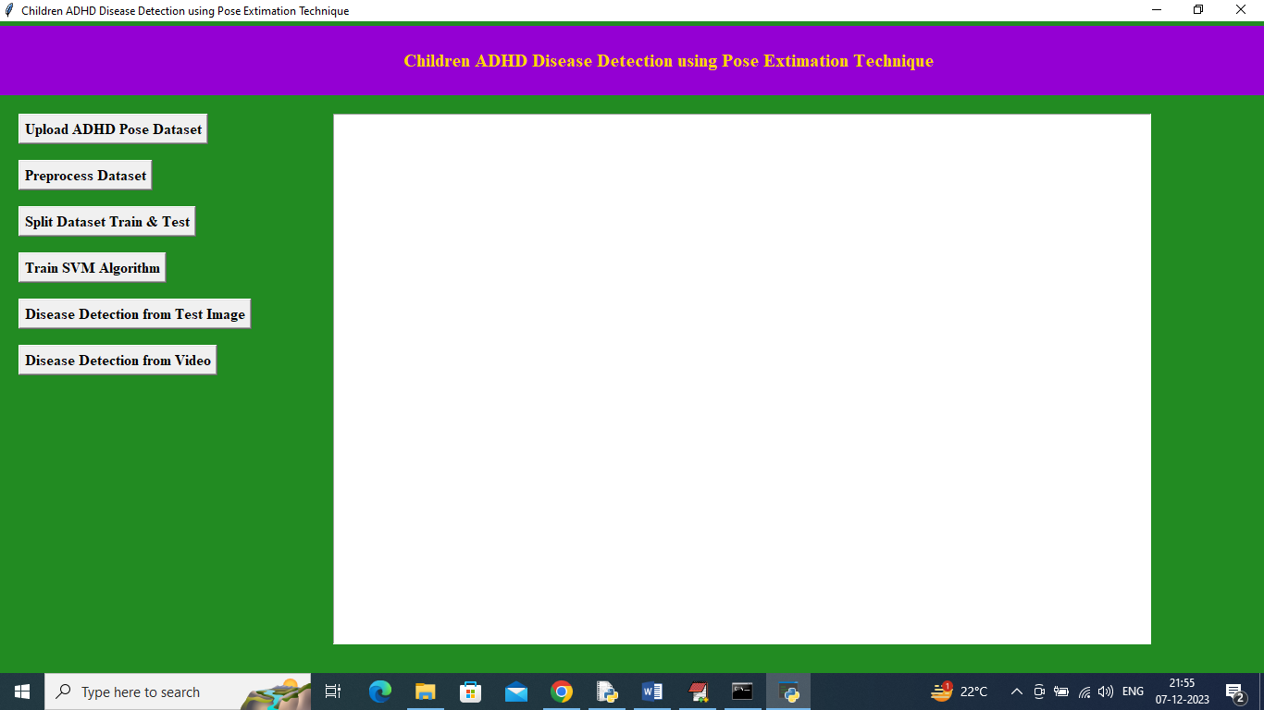
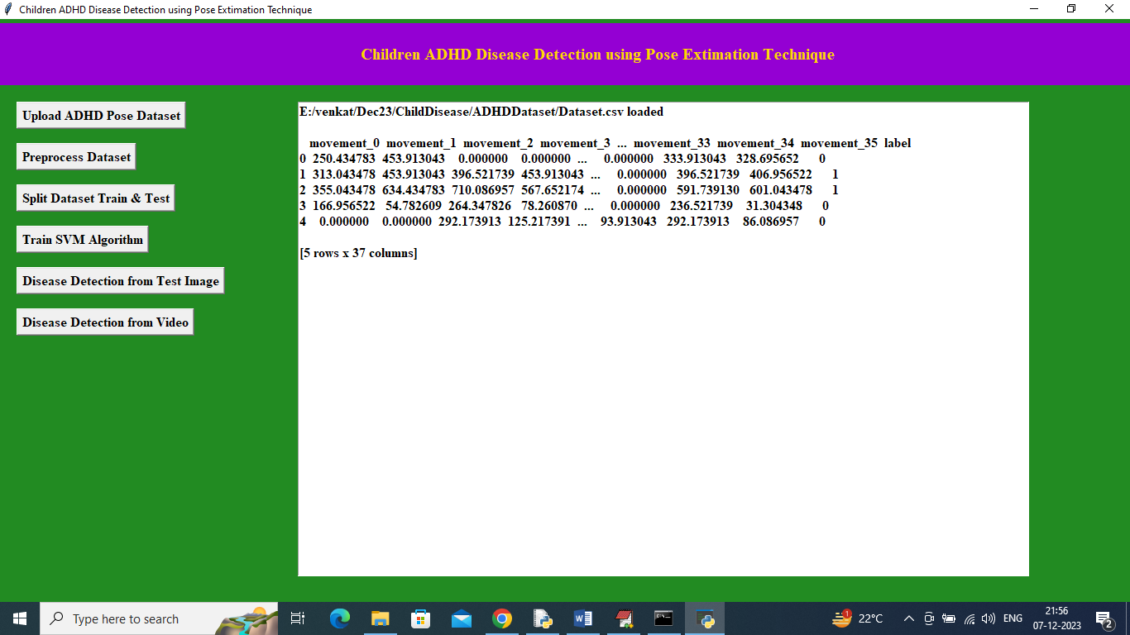
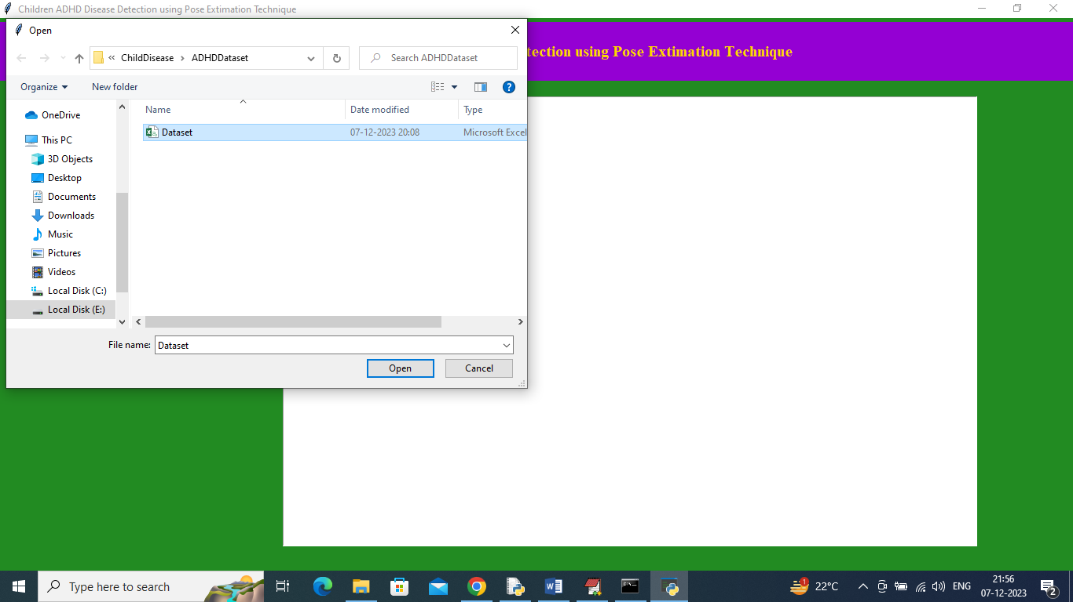
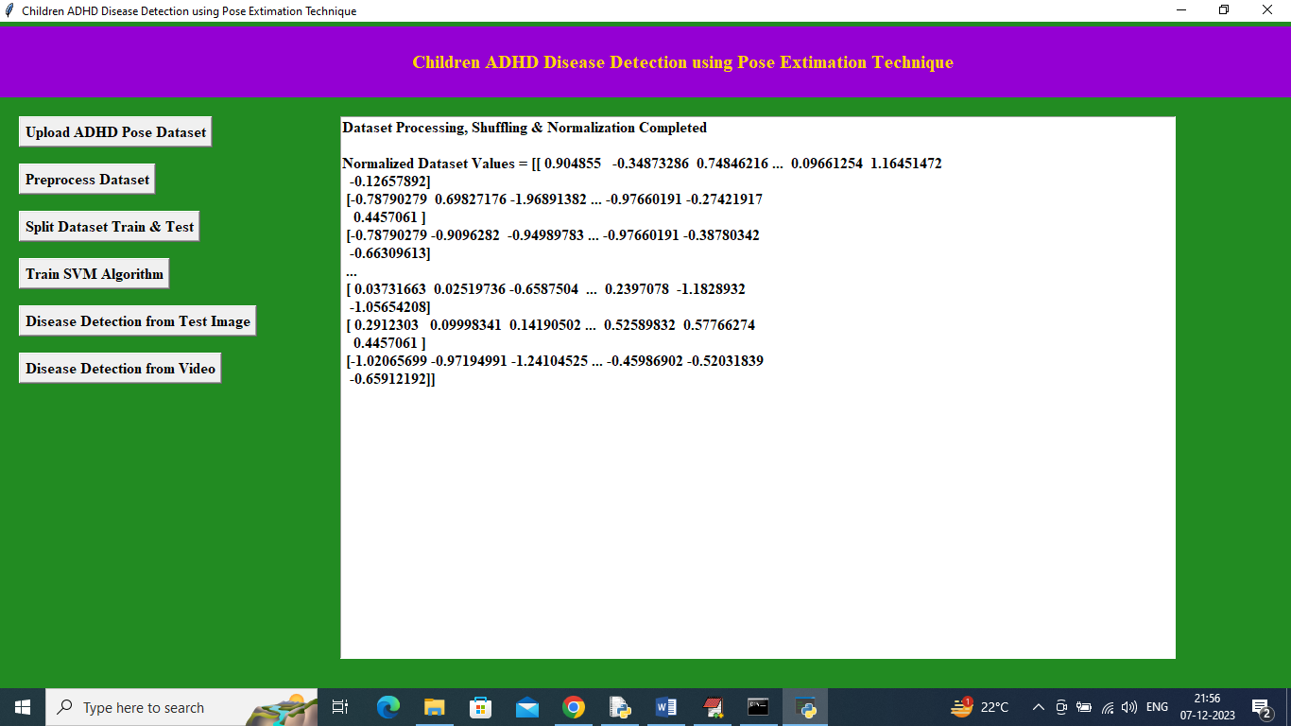
RESULTS:

Slide 24
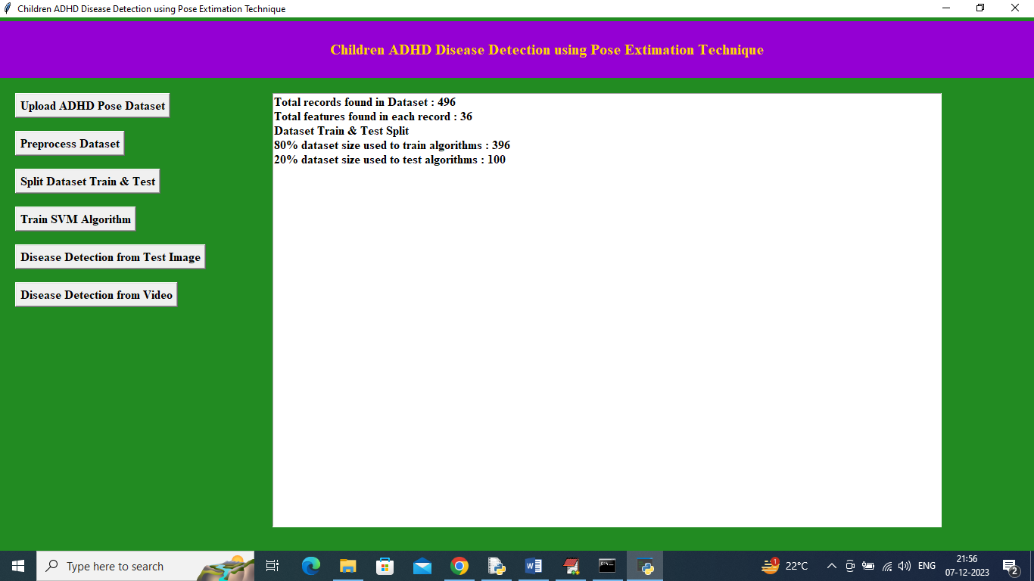
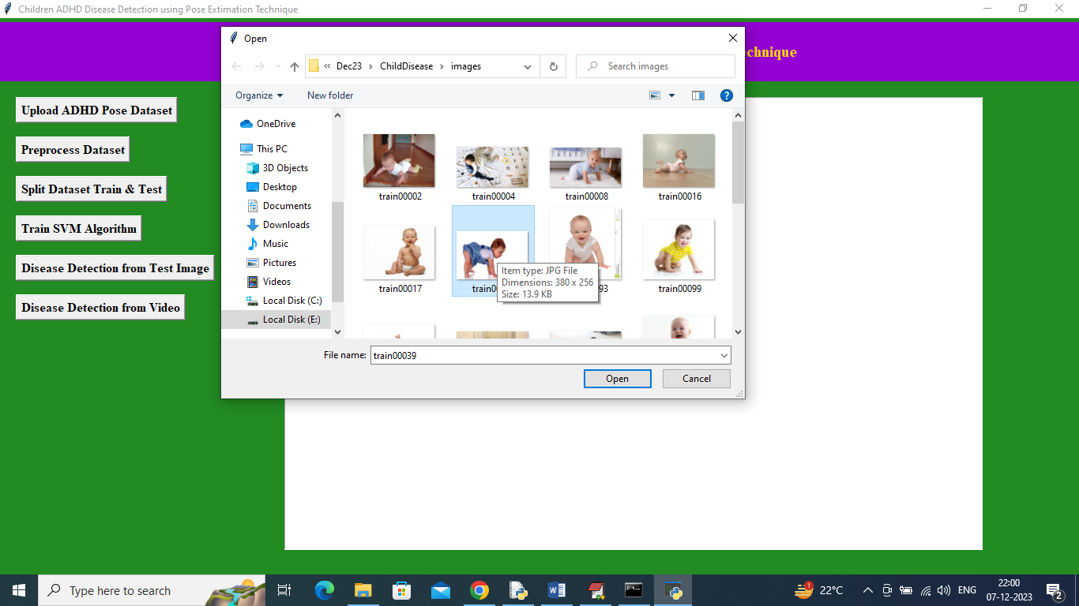
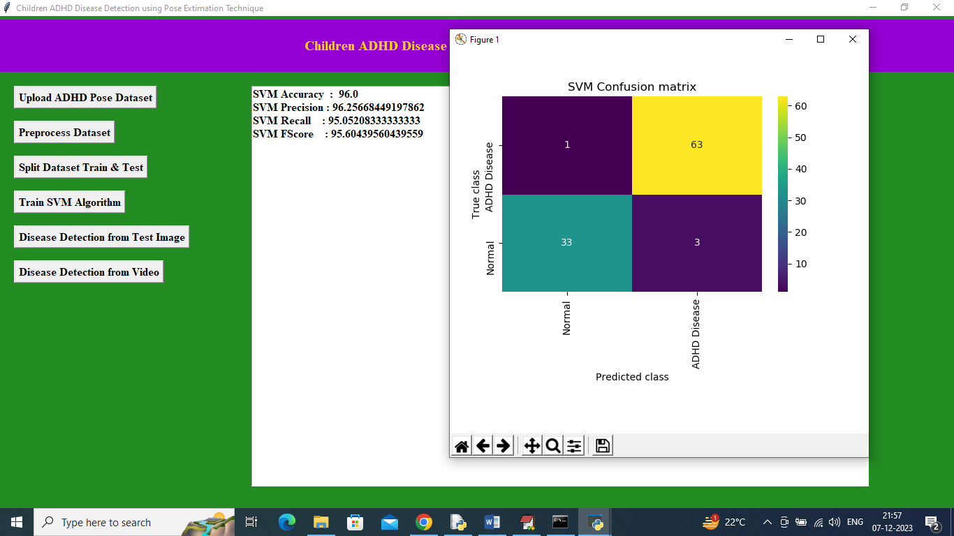
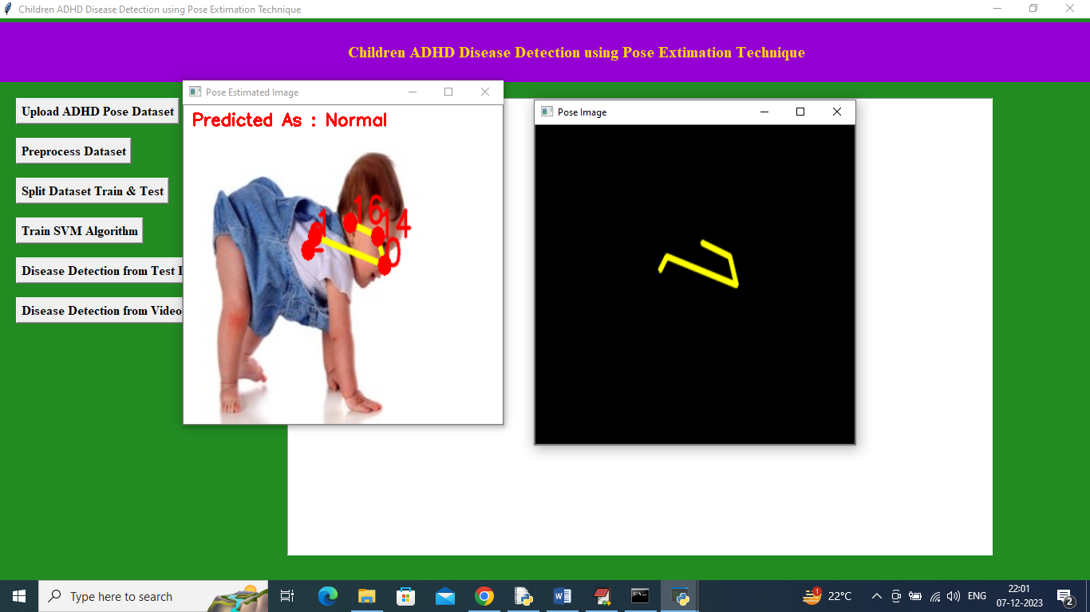

Slide 25
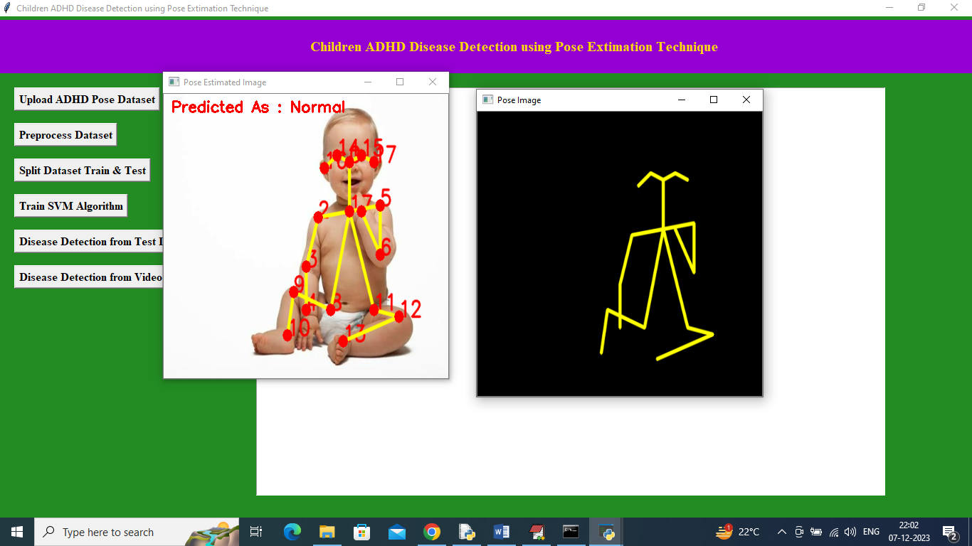
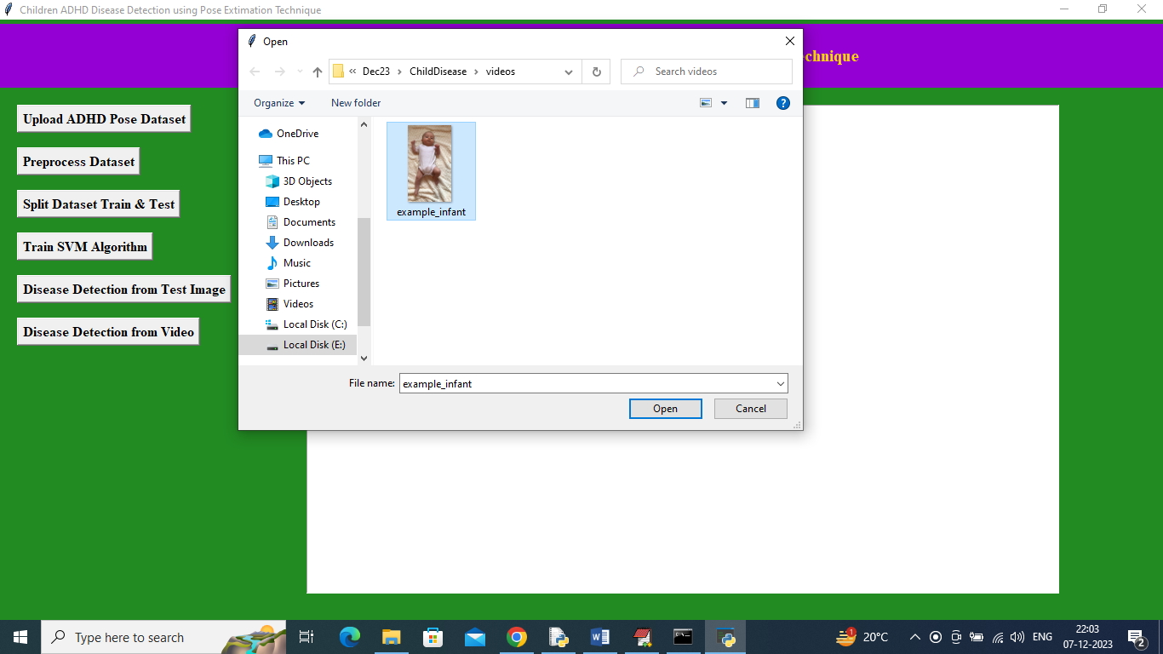
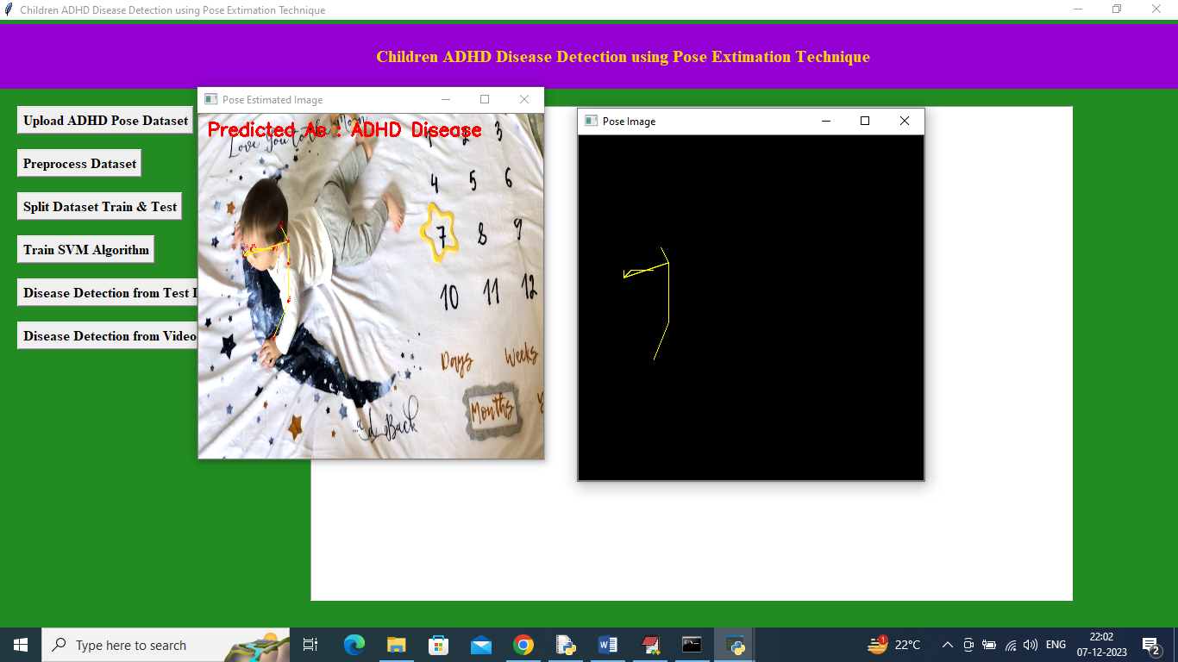
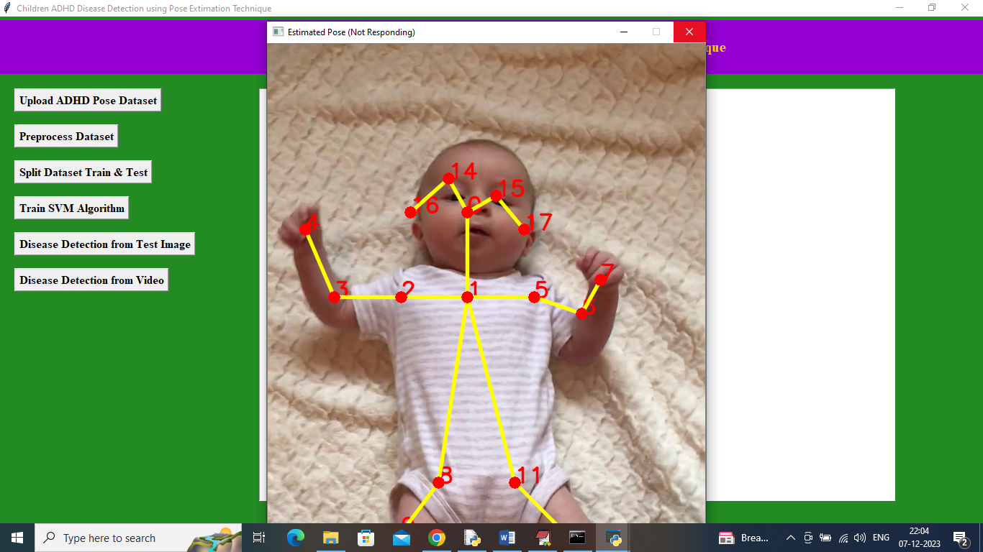

Slide 26
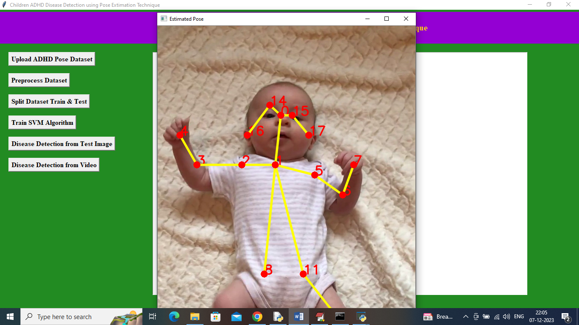
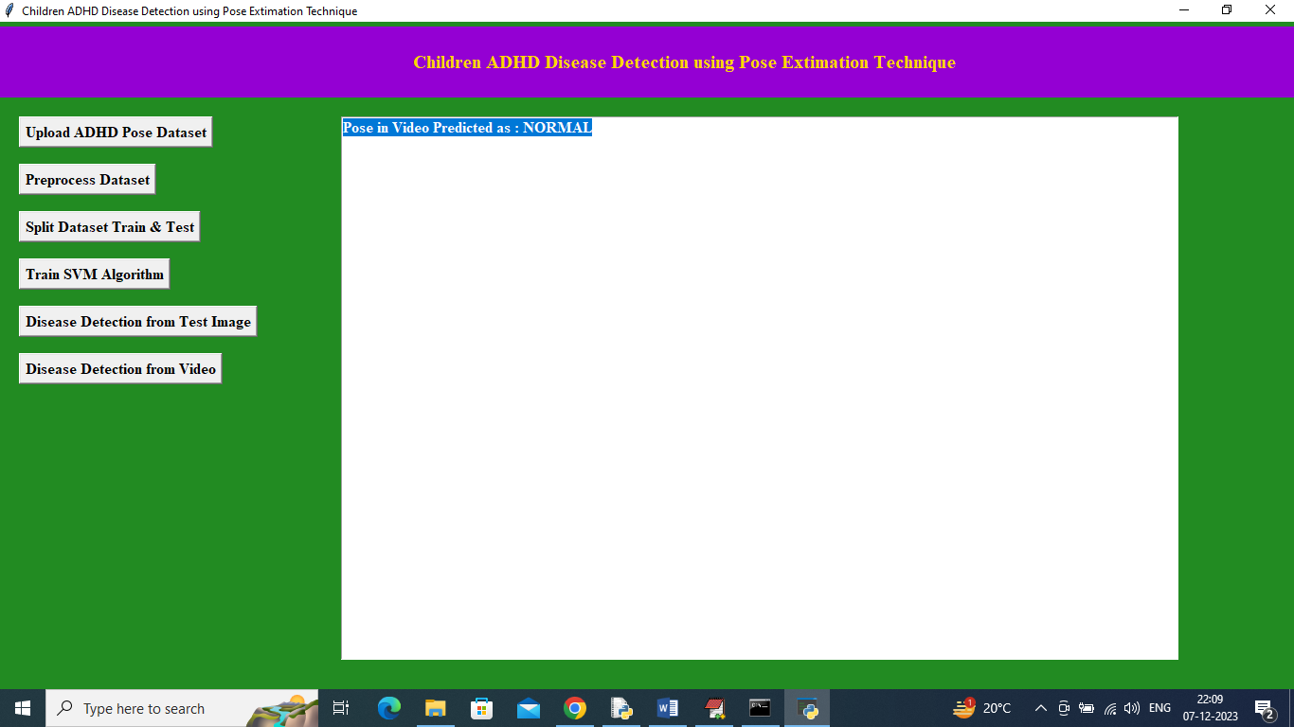

Slide 27
Conclusion & Future Enhancement:
The project successfully develops a real-time, non-invasive system for detecting ADHD in children using pose estimation and machine learning, accurately analyzing movement patterns, posture, and repetitive gestures. The combined use of MLP and DDS with Genetic Algorithm ensures reliable classification and continuous monitoring, supporting early intervention. Future enhancements could include 3D pose estimation, emotion recognition, and larger datasets to improve accuracy and generalization. Integration with mobile or cloud-based platforms would make the system more accessible for home or school monitoring, increasing its practical impact.

Slide 28
References:
Smith, J. "Challenges in ADHD Detection: A Review of Existing Systems and Limitations."
Johnson, E. "Pose Estimation Techniques in Healthcare: Applications and Advancements."
Brown, M. "Machine Learning Approaches to ADHD Detection: State-of-the-Art and Future Directions."
Davis, S. "Sensors and Data Collection for Pose Estimation in ADHD Assessments."
White, D. "Non-invasive ADHD Evaluation: The Role of Pose Estimation Technologies."

Slide 29
THANK YOU

